Slide 1


What’s the 3-1-1?
Ellaine Ho, Brian Lee, Omar Eltorai
beomb squad productions

Slide 2

Introduction & overview
Who
Call Center Manager – customer service analytics
What
Informed call type and volume estimations for improved customer service center management decisions
Why
Improved accuracy around staffing needs for greater expense control, minimal decrease in effectiveness
How
Inbound call analysis and granular predictions for user specified constraints (day and time)
What can NYC’s 3-1-1 call center expect?

Slide 3
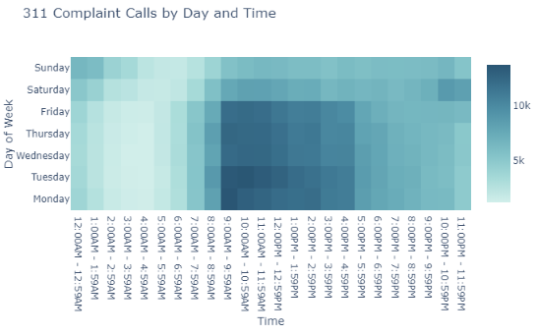
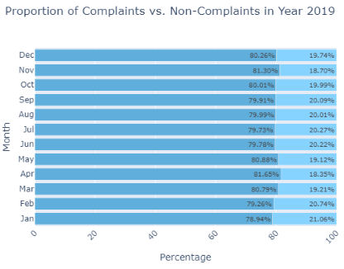

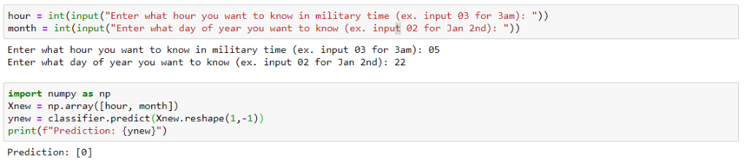
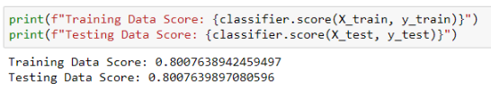
Analysis & model
Analysis
Model

